Slide 1
Welcome

Slide 2





MOVIE RECOMMENDATION DATABASE MANAGEMENT SYSTEM
"A perfect recommendation can make your day."

Slide 3
Presented By : | Presented To :
Name : Dipu banik Md. Sejon Hossain Id : 22201255 22201272 Section : E2 Group Name : Binary Brain | Alif Ruslam Lecturer CSE, UAP

Slide 4
Table of Content
Introduction
ER(Entity Relationship)Diagram
Schema Diagram
Entities And Attributes
Entity Relationships
Queries
Importance of Movie Recommendation Database Management System
Conclusion

Slide 5

INTRODUCTION
A Movie Recommendation Database Management System suggests movies to users based on their preferences. It enhances user experience by reducing the time to search for movies.

Slide 6
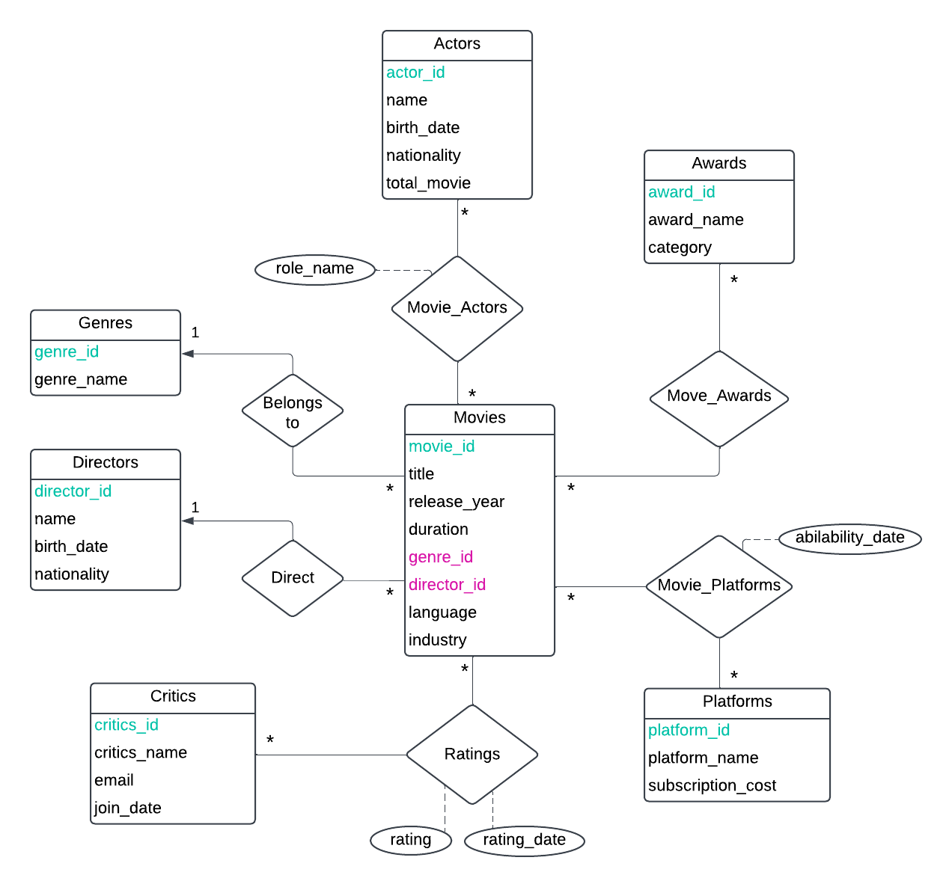
ER Diagram (Entity Relation Diagram)

Slide 7
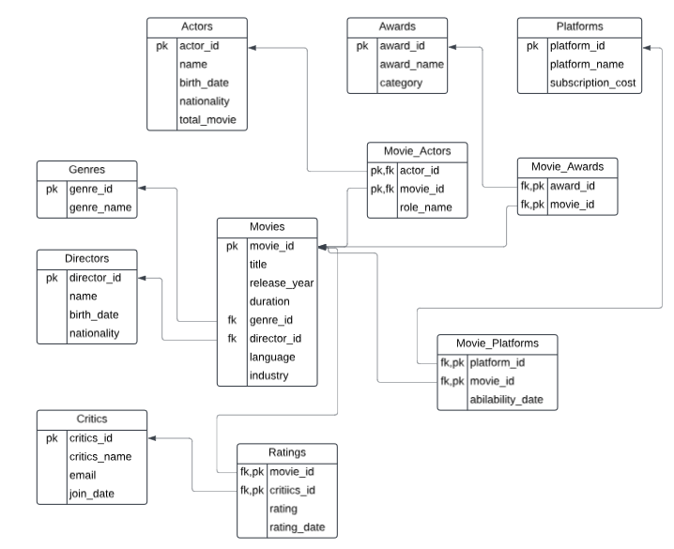
Schema Diagram

Slide 8
Entites & Attributes
Genres
Attributes : genre_id (pk) ,genre_name .
Purpose : Contain the data of available genres in the System
Directors
Attributes : director_id (pk), name, Date of birth, nationality
Purpose : Contain the data of directors in the System
Actors
Attributes : actor_id (pk), name, birth_date ,nationality, total_movie
Purpose : Contain the data of actors in the system.

Slide 9
Entities & Attributes
Awards
Attributes : award_id, award_name, category
Purpose : Contain the data of awards in the system
Platforms
Attributes : platform_id, platform_name, subscription_cost
Purpose : Contain the data of platforms in the system
Critics
Attributes : critics_id, critics_name, email, join_date
Purpose : Contain the data of critics in the sytem

Slide 10
Entities & Attributes
Movies
Attributes : movie_id( pk ), title, release_year, duration, genre_id( fk ), director_id( fk ),
language, industry
Purpose : Contain the data of movies in the system
Movie_Actors
Attributes : movie_id (pk, fk), actor_id ( pk, fk ), role_name
Purpose : Contain the data of movie actors act in movies in the system
Movie_Awards
Attributes : movie_id ( pk, fk ),award_id ( pk, fk )
Purpose : Contain the data of wining award of movies

Slide 11
Entities & Attributes
Ratings
Attributes : movie_id( pk, fk ), critic_id ( pk, fk ), rating, rating_date
Purpose : Contain the data of rating of movies given by critics
Movie_Platforms
Attributes : movie_id ( pk, fk ), platform_id (pk, fk ), avilability_date ,
Purpose : Contain the data of movies that reased in platform

Slide 12
Entitiy Relationships
Genres and Movies
Relationship : One to Many
Directors and Movies
Relationship : One to Many
Actors and Movies ( via Movie_Actors )
Relationship : Many to Many

Slide 13
Entitiy Relationships
Critics and Movies ( via Rating )
Relationship : Many to Many
Awards and Movies ( via Movie_Awards )
Relationship : Many to Many
Platforms and Movies ( via Movie_Platforms )
Relationship : Many to Many

Slide 14

How recommendation are generated ?
Critic Ratings Analysis :
Analyze critic preferences based on their ratings.
Genre Preferences :
Match movies of genres that users have highly rated.
Actor Preferences :
Suggest movies of favourite actors.
Platform Preference :
Suggests top-rated movies available on platforms.
Award Preference :
Suggests movies based on most award wins.

Slide 15
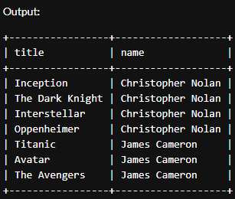
Queries & Output
Display movie list which is directed by Christopher Nolan or James Cameron.
(select title,name from movies natural join Directors where name='Christopher Nolan')
union
(select title,name from movies natural join Directors where name='James Cameron');

Slide 16
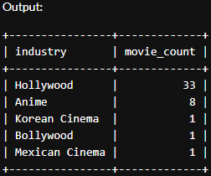
Queries & Output
Show the total number of films available by industry.
SELECT industry, COUNT(movie_id) AS movie_count
FROM Movies
GROUP BY industry
ORDER BY movie_count DESC;

Slide 17
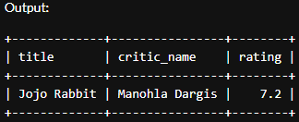
Queries & Output
Display critic name who gave lowest rate to a movie from the database.
select title,critic_name,rating
from Movies m join critics c join Ratings r
on c.critic_id=r.critic_id
and m.movie_id=r.movie_id
and rating in
(select min(rating)
from Movies m join Ratings r
on m.movie_id=r.movie_id);

Slide 18
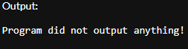
Queries & Output
Find actors who act in all type of movie genres.
SELECT a.name AS actor_name
FROM Actors a
JOIN Movie_Actors ma ON a.actor_id = ma.actor_id
JOIN Movies m ON ma.movie_id = m.movie_id
JOIN Genres g ON m.genre_id = g.genre_id
GROUP BY a.actor_id, a.name
HAVING COUNT(DISTINCT g.genre_id) = (SELECT COUNT(*) FROM Genres);

Slide 19
Importance of Movie Recommendation Database Management System
Enhance user satisfaction by offering personalized suggestions.
Increase user engagement on streaming platforms.
Reducing the time spent searching for movies.

Slide 20

Conclusion
In conclusion, movie recommendation database management systems play a vital role in enhancing user experience by providing personalized suggestions and simplifying content discovery.

Slide 21

RESOURCES
Slide & Templete:
Powerpoint
Slidego
Photos:
Google

Slide 22

Do you have any questions?

Slide 23

THANKS!
CREDITS : This presentation is created by
Dipu Banik & Md. Sejon Hossain
22201255@uap-bd.edu
22201272@uap-bd.edu

